Slide 1
T06
BASIC LEAN TRAINING
Principle 6
People and the culture of the working environment
The European Commission's support for the production of this publication does not constitute an endorsement of the contents, which reflect the views only of the authors, and the Commission cannot be held responsible for any use which may be made of the information contained therein.

Slide 2
Objectives
The objectives of this chapter are:
For any lean implementation the most important thing is the organisational culture, the leadership and the way of thinking which will lead to commitment.

Slide 3
Lean is…
…a philosophy that improves work from the customer´s point of view.
… a respectful attitude and the way to act in the work environment (culture).
… an action strategy. This is how we achieve our goals together.
… a way to make things more efficient

Slide 4
Lean isn’t…
… a way to fire people
… based only on a list of tasks to do
… a substitute for poor management
… independent from your workforce

Slide 5
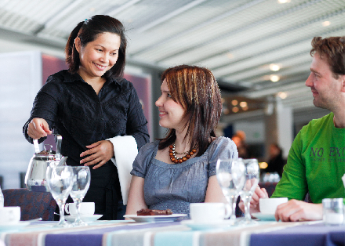
The goal is a satisfied customer
"We work together with Lean, with as little waste as possible. We do this according to the wishes of the customer and from the customer's point of view"

Slide 6
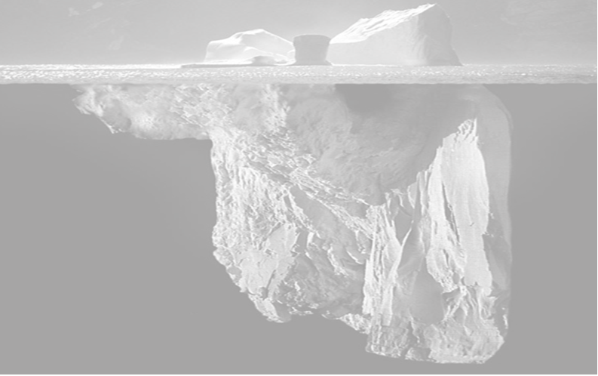
Lean results
A fifth part of Lean's results is generated by Lean's tools
Most of the Lean results come from people:
attitudes
ways of thinking
respect for others
unspoken rules
of the work community's culture
good managament skills

Slide 7
People and the culture of the working environment
Characteristics
Strategy
Customer Satisfaction
Traditional
Produces what you think sells.
Mass production – big production volumes
LEAN
Focus on the Customer - Produce when and in the quantity the customer wants
Reduced response time – small scale production – one piece flow
Leadership
Executive command
Vision and global participation
Notes:
Time managers spend on the team

Slide 8
People and the culture of the working environment
Characteristics
Production
Organization
Traditional
Large scale equipments, functional layout, long production times, excessive inventory.
Vertical structure – execution of orders, information flow in “silos”.
LEAN
Human scale equipments, working cell layout, short production times, “zero inventory”, zero defects.
Horizontal Structures – along the production’s value chain, which encourage teamwork among various departments.
Culture
Loyalty and obedience
Harmony and involvement based on human resources development
Notes:
Time managers spend on the team

Slide 9
People and the culture of the working environment
Trust
Honesty
Openness
Consciousness
Respect
Observation
Objectivity
Know how to listen
…..
Blaim
Ego
Mistrust
Cynicism
Sarcasm
Ambiguity
Subjectivity
Negativity
…..

Slide 10
People and the culture of the working environment
Lean sustainability
FAQ’s:
At the beginning….
Where should I start?
Is there any roadmap I can follow?
What does "Lean thinking" involve?
Who should I involve?
Is it only applicable to the factory shop floor?
Is it only applicable to production companies?
What will be the benefits?
Will it make me more profitable?

Slide 11
People and the culture of the working environment
Lean sustainability
FAQ’s:
During…
How long does it take until benefits start appearing?
How long does it take until the benefits start to disappear?
Why did people begin to lose their enthusiasm?
What is the secret to sustainability?
What is the difference between managing and leading Lean change?
How do we ensure that the workforce continues to "buy" Lean?
Notes:
Add the explanations

Slide 12
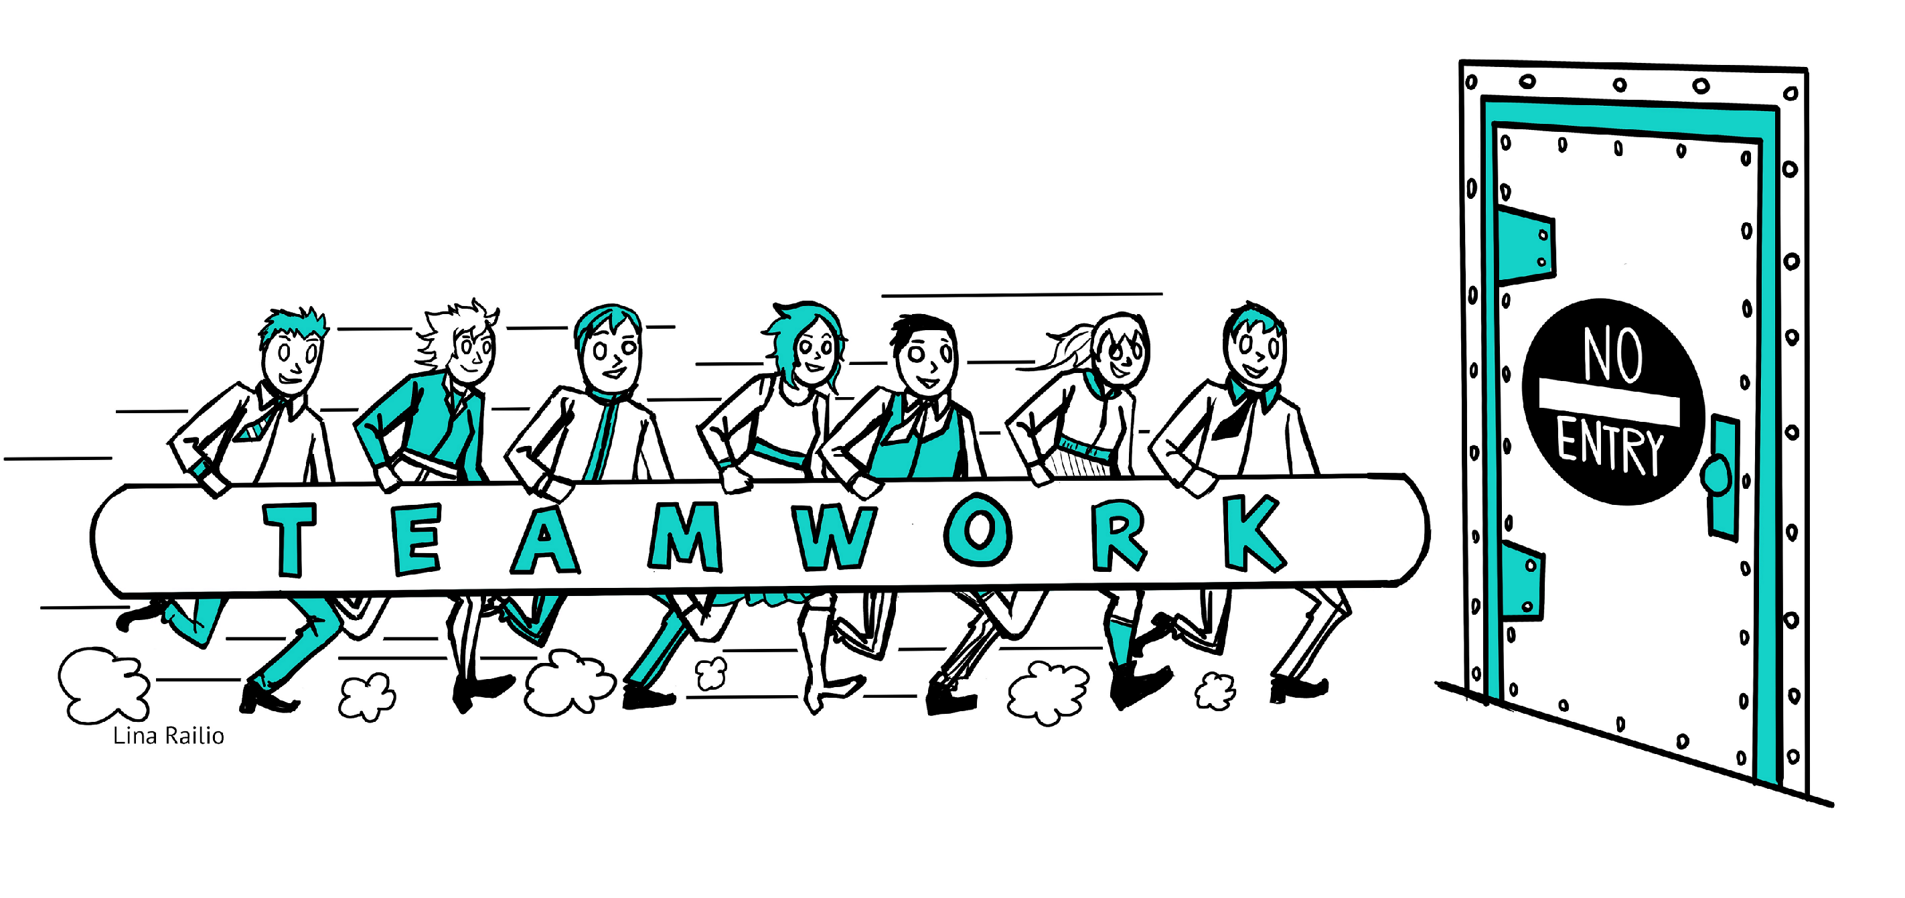
Lets work together and improve
You
can´t
Notes:
At this moment it will be done the 2nd and 3rd round of the Ball Game (T00B-Gb)

Slide 13
Other exercises
Ball Game
(rounds 2 and 3)
Notes:
Ball Game (T00B-Gb)

Slide 14
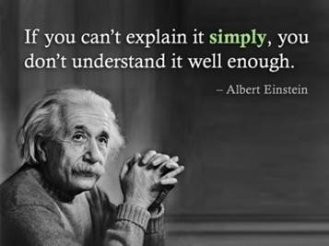

Slide 15
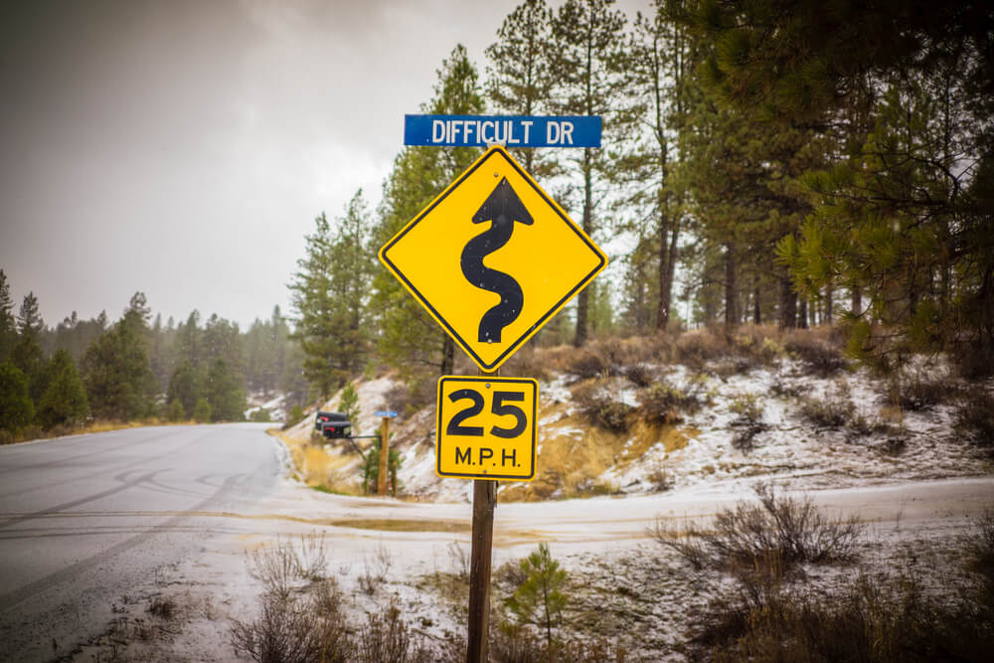
”We do not try to run faster, but we decided to walk a shorter distance”
Taiichi Ohno–Toyota. Inventor of JIT system

Slide 17
LEAN FOR WORK AND LEAN FOR LIFE
Train the trainer to teach Lean skills in VET

