Slide 1
T00- A
BASIC LEAN TRAINING
Learning Objectives
The European Commission's support for the production of this publication does not constitute an endorsement of the contents, which reflect the views only of the authors, and the Commission cannot be held responsible for any use which may be made of the information contained therein.

Slide 2
Objectives
The Student will develop basic knowledge, skills and competences in the LEAN area.
Specifically, at the end of the training the student will:
Know about continuous improvement methodologies.
Know how to the use of Lean methodologies.
Identify the main concepts of the Lean production and tools of analysis for productive systems.
Identify the difference between value added and non-value added.
Develop “Value Stream Mappings” (VSM).
Apply Lean tools to practical cases.
Apply continuous improvement practices into daily activities.

Slide 3
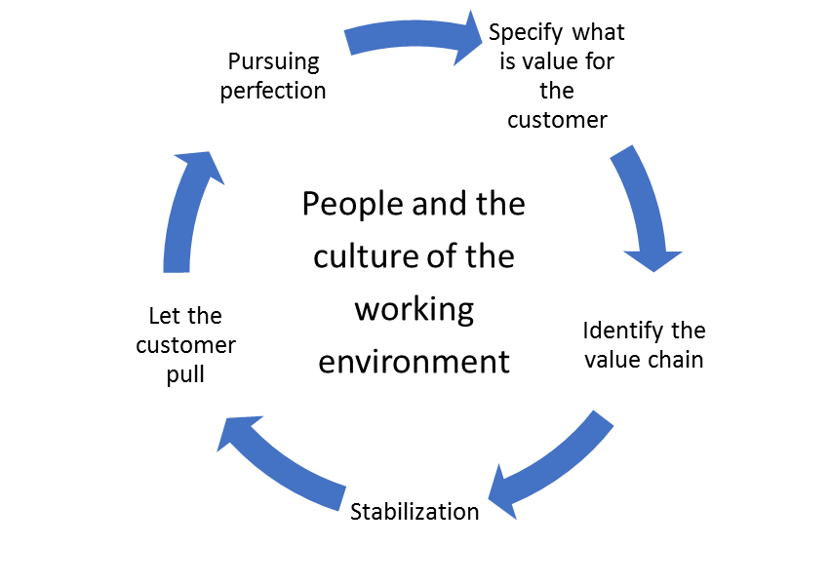
Training Program
Introduction to Lean
5 Principles
Principle 1: Specify what the value is for the customer
Principle 2: Identify the value chain
Principle 3: Stabilization
Principle 4: Let the customer Pull
Principle 5: Pursuing perfection
Also included: - People and the culture of the working environment
- Summary
Principle 5
Principle 1
Principle 4
Principle 2
Principle 3
Notes:
Introduction to Lean:
Lean history
Lean main concepts
Lean examples
Why Lean

Slide 4
LEAN FOR WORK AND LEAN FOR LIFE
Train the trainer to teach Lean skills in VET

