Slide 1
​
T00B-Ga
BALLPOINT PEN GAME
Discover all basic
LEAN principles​
​

Slide 2
INTRODUCTION : ​
The aim is to put this good quality product of a ballpoint pen on the market. ​There is a lot of competition in the ballpoint pens industry. ​​
The customer is the king.
The company will always strive to meet the wishes of the customer.​
​The working day takes 4 minutes. ​
There are a minimum of 2 and a maximum of 3 production days.​
You get 10 minutes of preparation time. in In the preparation time of the second and third round everybody may renovate or reduce the waste. ​

Slide 3
The various working activities are recorded in one-point lessons. Given the nature of the work, it is not possible for one employee to make the
entire ballpoint pen. ​
The customer demand is 28 ballpoint pens each day. ​
The key performance indicators (KPI’s) are evaluated at the end of each day:
Time production 1st ballpoint pen
Number of well-supplied ballpoint pens
Number of incorrect ballpoint pens
Number of semi-finished products in the process
Process time per part of the ballpoint pen​​
​

Slide 4
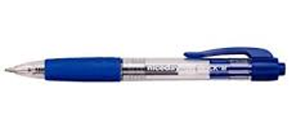
BALLPOINT PEN FABRIC

Slide 5
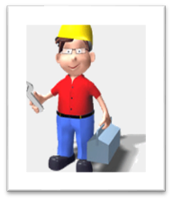
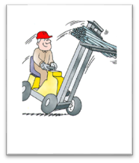
FLOOR PLAN BALLPOINT PEN FABRIC ​
S
TORE
OPL NR 8
OPL NR 3
OPL NR 5
OPL NR 7
OPL NR 2
OPL NR 1
OPL NR 7
OPL NR 4
OPL NR 6
OPL NR 9

Slide 6
ONE POINT LESSON NUMBER 1
OPL METHOD : COSTUMER ​
DISCRIPTION: ​
As a customer you would like to include this product in your assortment.​
​
You do not like to disappoint your customers, therefore
quality and on-time delivery are important to you.​
​
You expect at least 28 ballpoint pens a day.
​

Slide 7
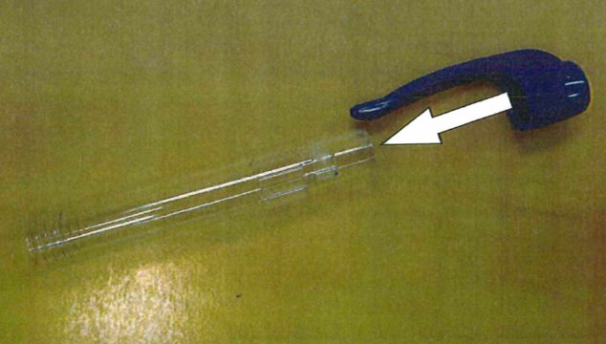
ONE POINT LESSON NUMBER 2 OPL METHOD :
APPLY THE BREAST POCKET CLIP TO THE BALLPOINT PEN ​
DISCRIPTION:
​
You are specialized in applying the clip to the ballpoint pen. ​
​
​
​
Follow the (visual) instruction. ​

Slide 8
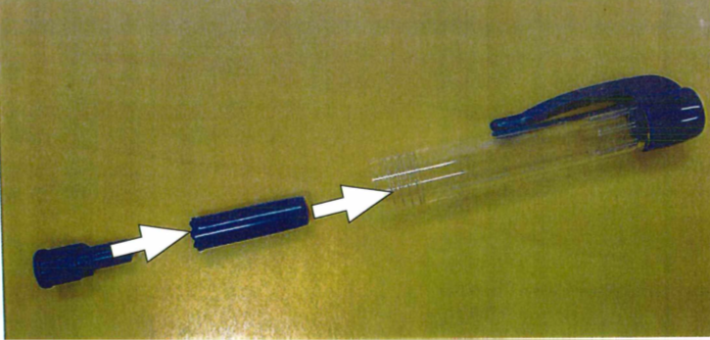
ONE POINT LESSON NUMBER 3 ​
OPL METHOD : FITTING THE PUSH-BUTTON MECHANISM OF ​
THE BALLPOINT PEN
DISCRIPTION: ​
You are specialized in applying the push-button mechanism
of the ballpoint pen.
​
Follow the (visual) instruction.
​

Slide 9
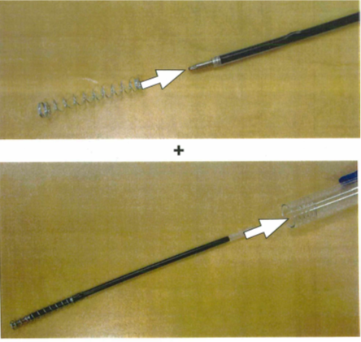
ONE POINT LESSON NUMBER 4 ​
OPL METHOD : ATTACHING THE INK CARTRIDGE INCLUDING THE SPRING ​
DISCRIPTION: ​
​
You are specialized in applying
the ink cartridge and spring of the ballpoint pen. ​
​
​
Follow the (visual) instructions.
​

Slide 10
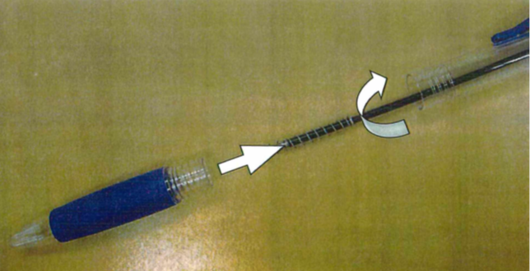
ONE POINT LESSON NUMBER 5 ​
OPL METHOD : FITTING THE SCREW CAP
DISCRIPTION: ​
You are specialized in
installing the screw cap of the ballpoint pen.​
​
Follow the (visual) instruction.

Slide 11
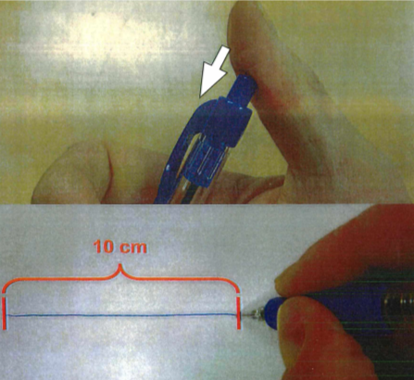
​ONE POINT LESSON NUMBER 6​
OPL METHOD : QUALITY CONTROL OF THE BALLPOINT PEN
DISCRIPTION:
The ballpoint pen must meet two quality requirements: ​
1. It must write at least 10 cm​
2. The push button mechanism must function properly in 1x
Afterwords you registrate the number of correct and rejected ballpoint pens.​

Slide 12
ONE POINT LESSON NUMBER 7​
OPL METHOD : TRANSPORTATION ​
DISCRIPTION: ​
You are a very fast and skilled forklift driver and a truck driver.
Your transport consists of:​
• raw materials from the store to the production workers​
• semi-finished products between process steps​
• rejected ballpoint pens from the quality inspector to the first
production worker
• ballpoint pens to the customer ​
Pay attention!! You use the customized transport pallets for transporting
only 4 ballpoint pens at a time intern (to the production workers) and extern (to the customer). ​

Slide 13
ONE POINT LESSON NUMBER 8 ​
OPL METHOD : PROCESS MONITORING BY TAKING MEASUREMENTS​
DIRECTOR
PROCESS GUARD
INK CARTRIDGE& SPRING
QUALITY CONTROL-LER
SCREW CAP
DRIVER
CLIP
PUSH BUTTON
SEE THE OTHER SIDE

Slide 14
DISCRIPTION: ​
As a process guard you are responsible for correct information provision to the management board. You are also controlling the process if the director is not present.
The director would like to have information to a number of key performance indicators (KPI’s):
1) Number of good and rejected ballpoint pens. ​
2) Total duration (= lead time) of the first good ballpoint pen.
3) Required duration per activity in making the ballpoint pen (= process time) ​
​
Record this information on A4 and hand it to director at the
end of the working day. ​
PAY ATTENTION!! Often the director is not available during the day.

Slide 15
ONE POINT LESSON NUMBER 9 ​
OPL METHOD : DIRECTOR/GAME LEADER​
As a director you are promoting this new product; THE ballpoint pen.​
You are visiting potential customers and you maintain good contact with
current customers. You invest by visiting them regularly.​
The process guard takes over your duties.
At the end of the working day you request feedback from the process guard.
You encourage continuous improvement among all employees. ​
They are getting space to implement improvements (=preparation
time). ​
see the other side​

Slide 16
The key performance indicators (KPI’s) are :
Time production 1st ballpoint pen
Number of well-supplied ballpoint pens
Number of incorrect ballpoint pens
Number of semi-finished products in the process
Process time per part of the ballpoint pen​​
After every working day you discuss the results of the KPI’s.
You also ask about the satisfaction:
Customer satisfaction (in number)​
Staff satisfaction (in number)​
NOTE : Challenge everyone to come up with solutions and experiment in the second and third round.

